Slide 1
AI in de gezondheidszorg: hip hip hoera of AIAI?
Prof Dr W. Van Biesen
Universitair Ziekenhuis Gent
Consortium for Justifiable Digital Healthcare

Slide 2
AI: hoe werkt het (niet) in 2023
Applicaties van AI in gezondheidszorg en in nefrologie
Valkuilen
Impact op zorgverleners

Slide 3
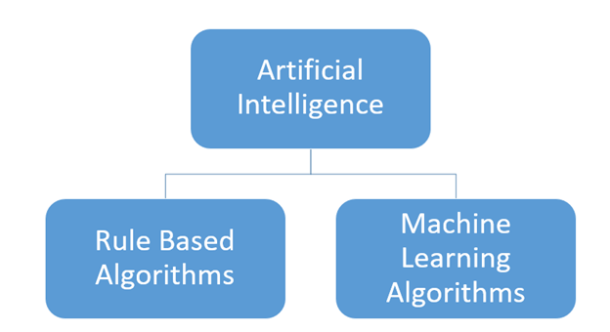

Slide 4
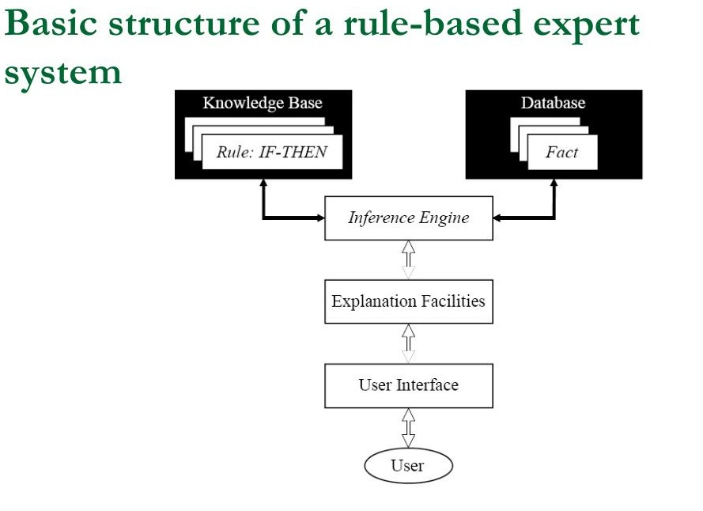
DEDUCTIE

Slide 5
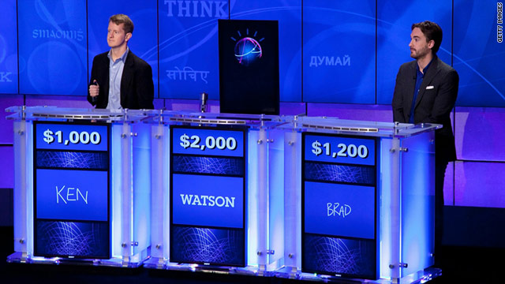

Slide 6
U wil de medicamenteuze behandeling ProductE® van een nieuwe net opgenomen patiënt inbrengen in het systeem.

Slide 7

Actie niet toegelaten
a

Slide 8
ProductE ®
niet voorradig in het formularium
b

Slide 9
ProductE ®
niet voorradig in het formularium
Alternatief: ProductU®
c

Slide 10

Mogelijks interacties met andere medicatie
a

Slide 11

SUGGESTIE
Gebaseerd op de anamnese, beeldvorming en labowaarden van deze patiënt is
ProductU ®
mogelijks een beter alternatief
e

Slide 12
Mogelijke interactie
met medicatie:
A (lagere Spiegel)
X (hogere Spiegel)
Y (toename risico op aritmie)
Alternatief: ProductU ®
e

Slide 13
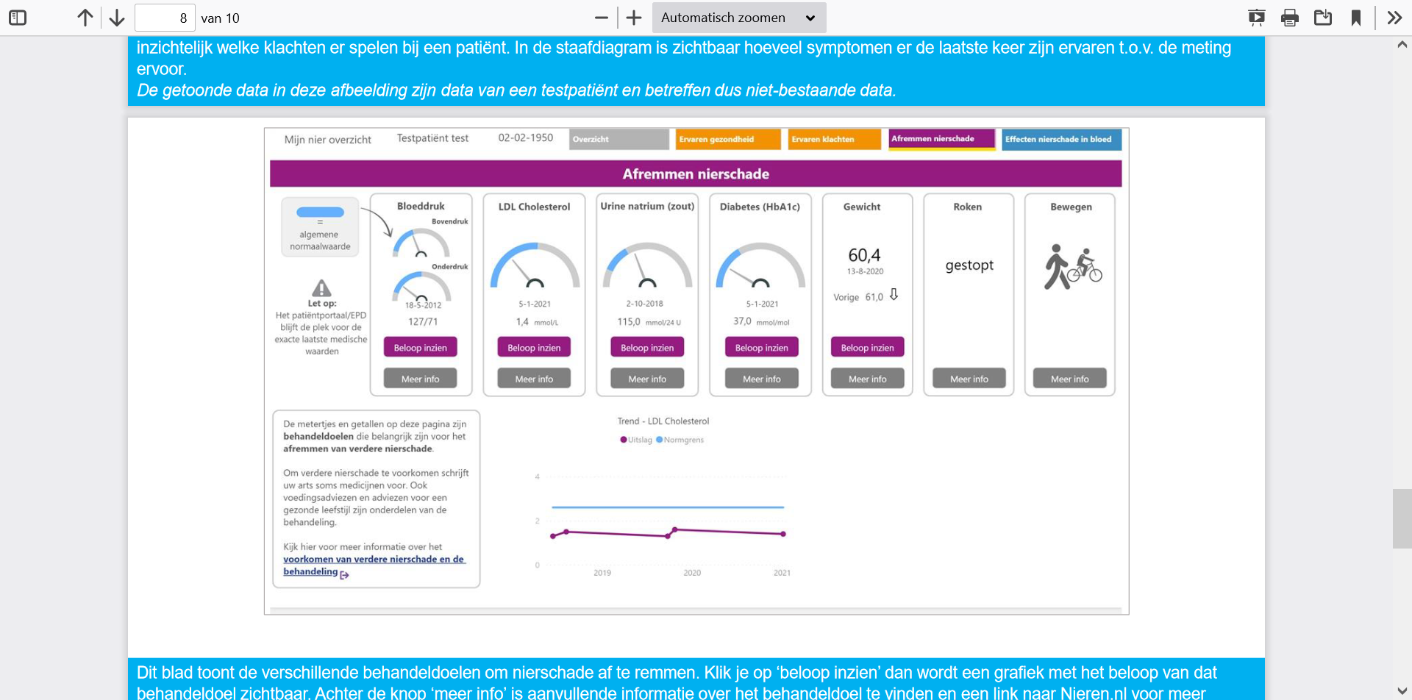

Slide 14
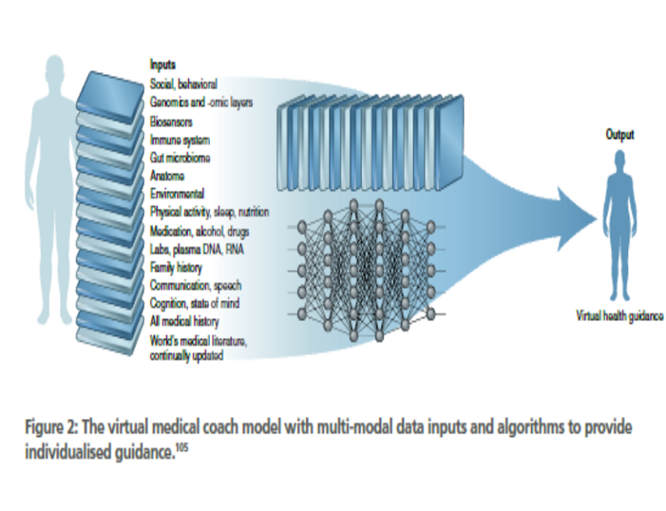
INDUCTIE

Slide 15
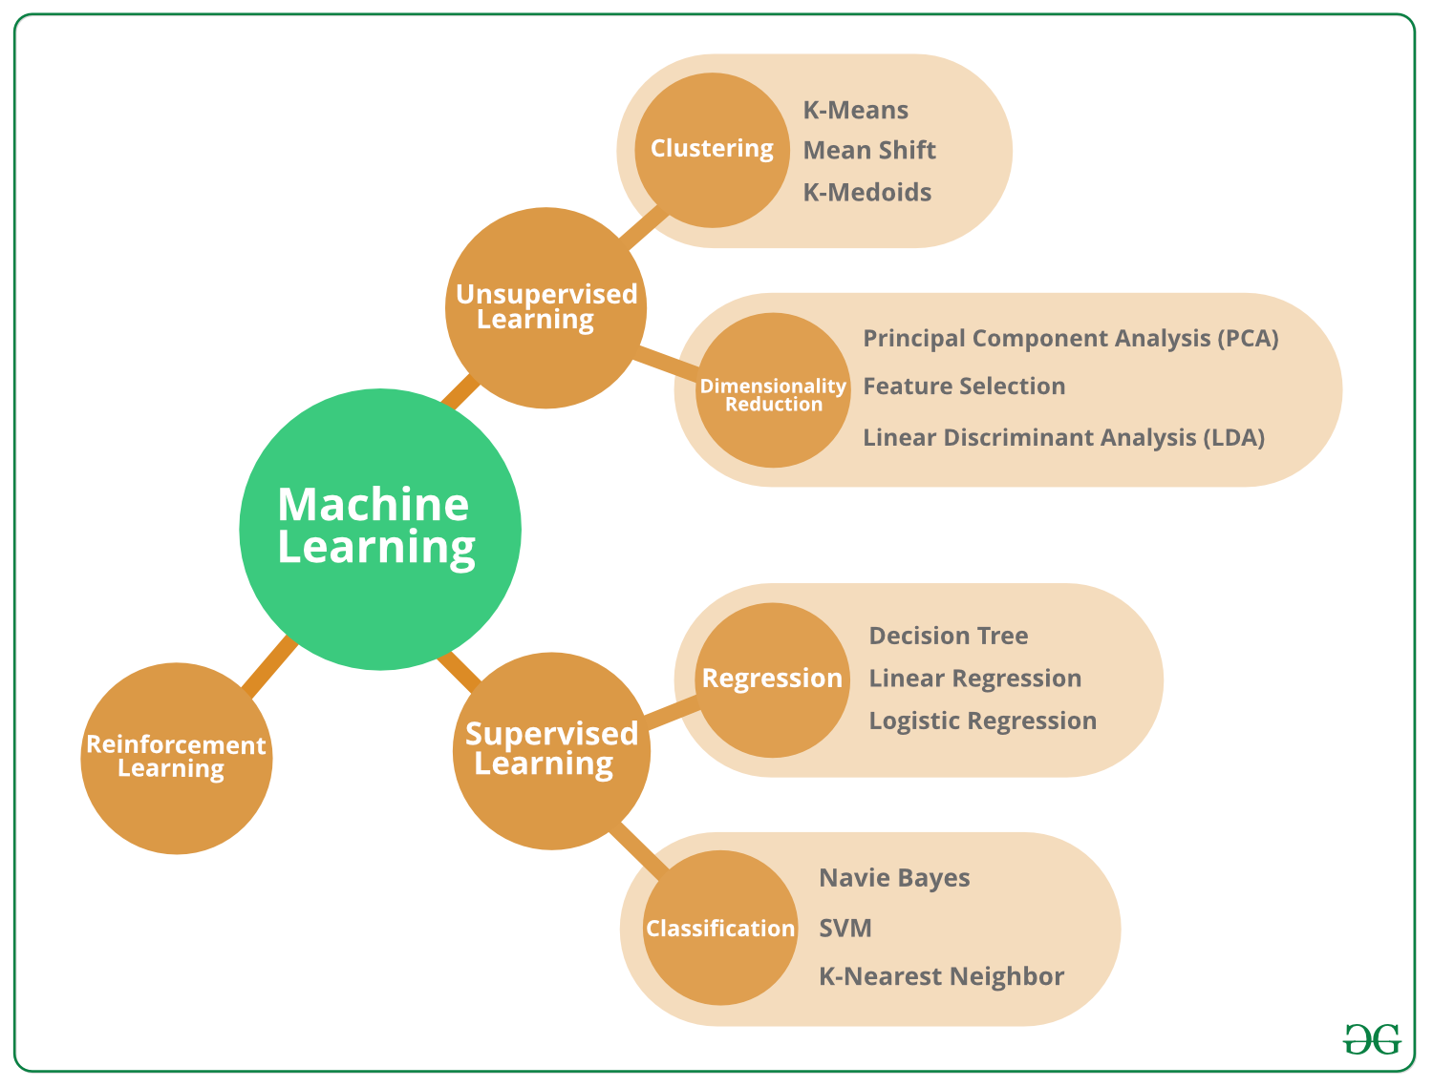

Slide 18
GENERAL PRETRAINED MODELS
GENERATIVE AI
FOUNDATION MODELS

Slide 20
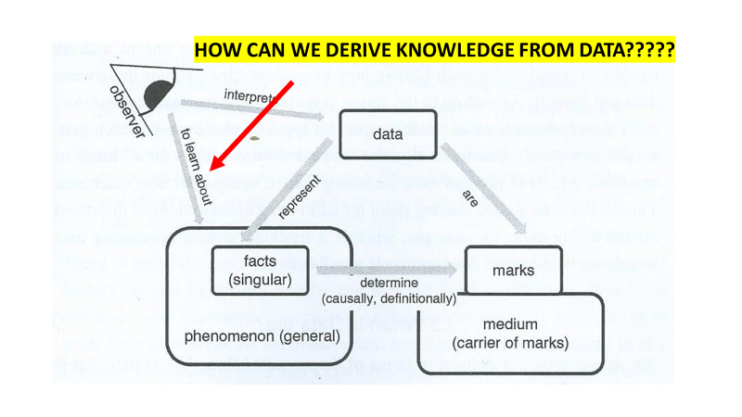

Slide 21
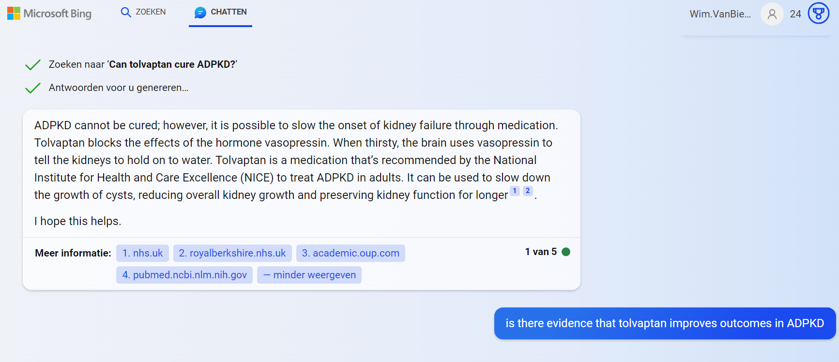

Slide 22
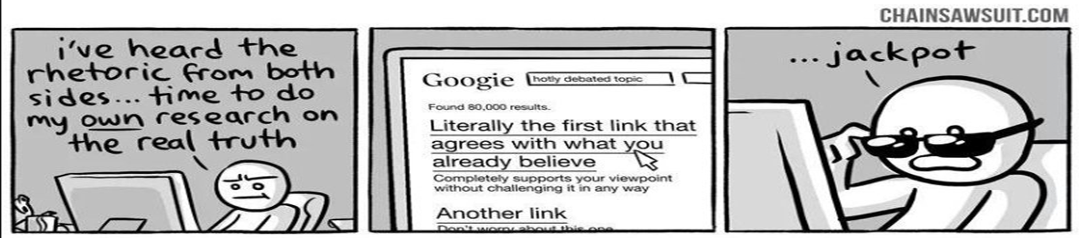

Slide 23
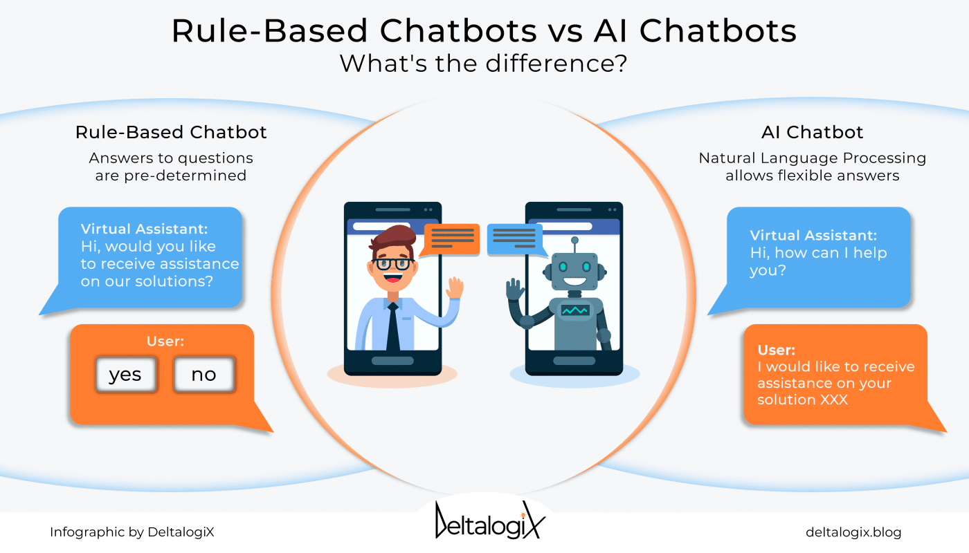

Slide 24

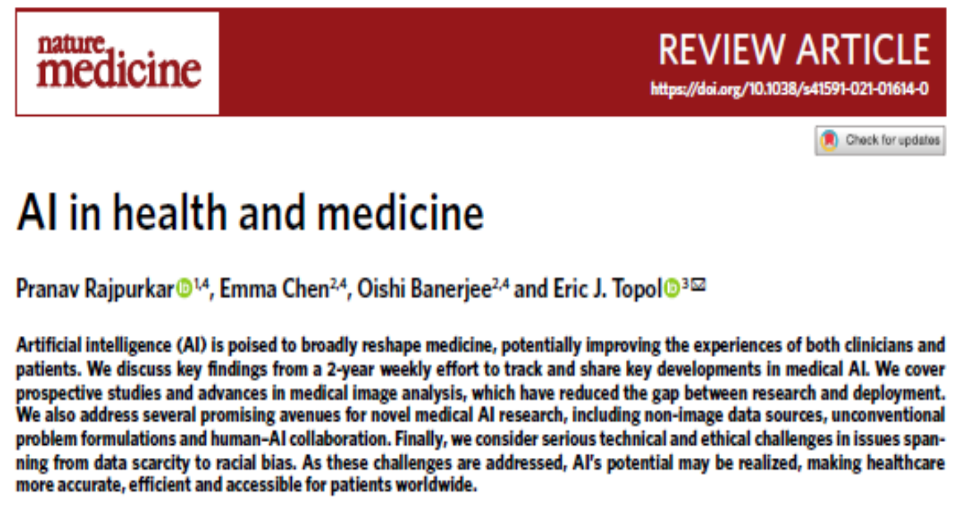

Slide 25
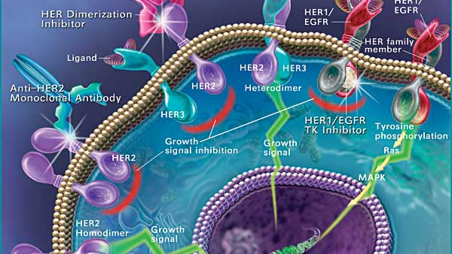

Theoretical and Basic research

Slide 26
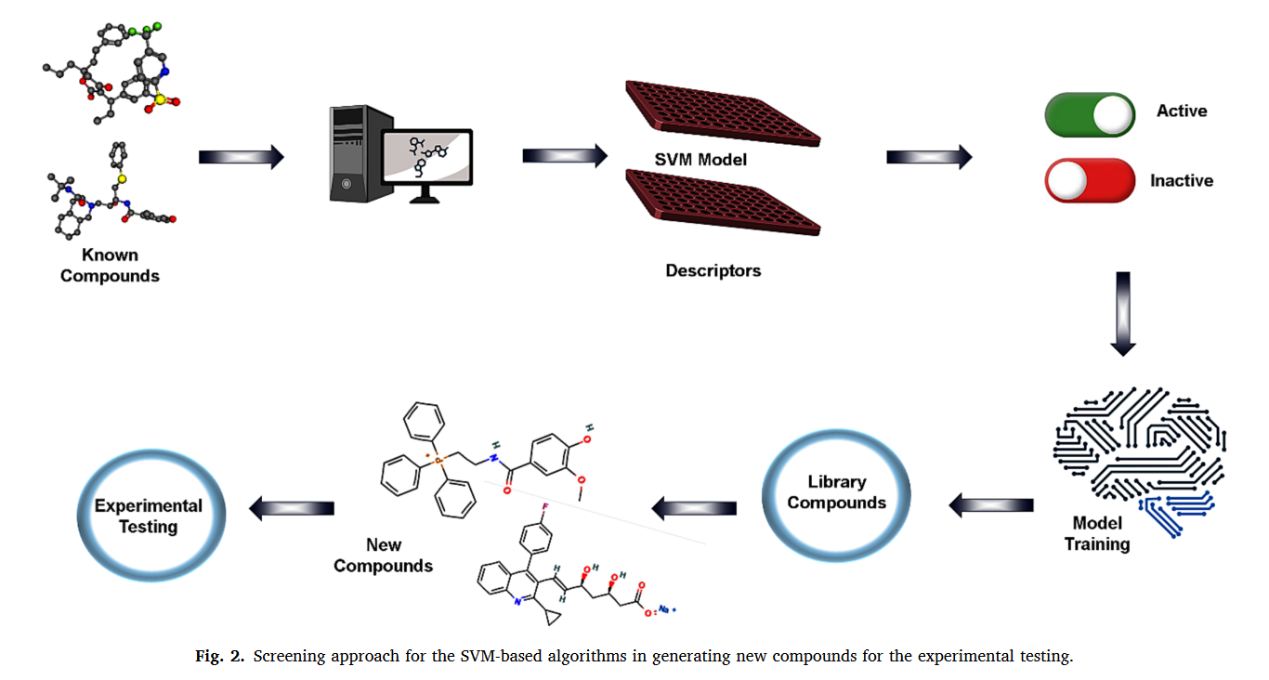

Slide 27
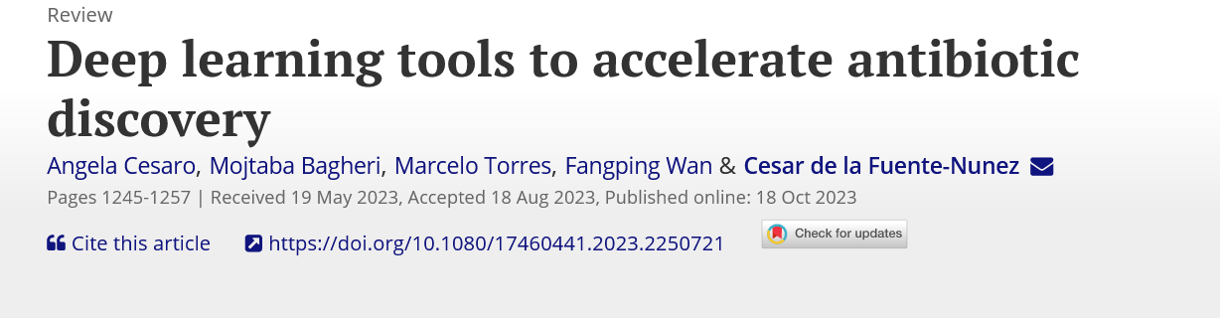

Slide 28
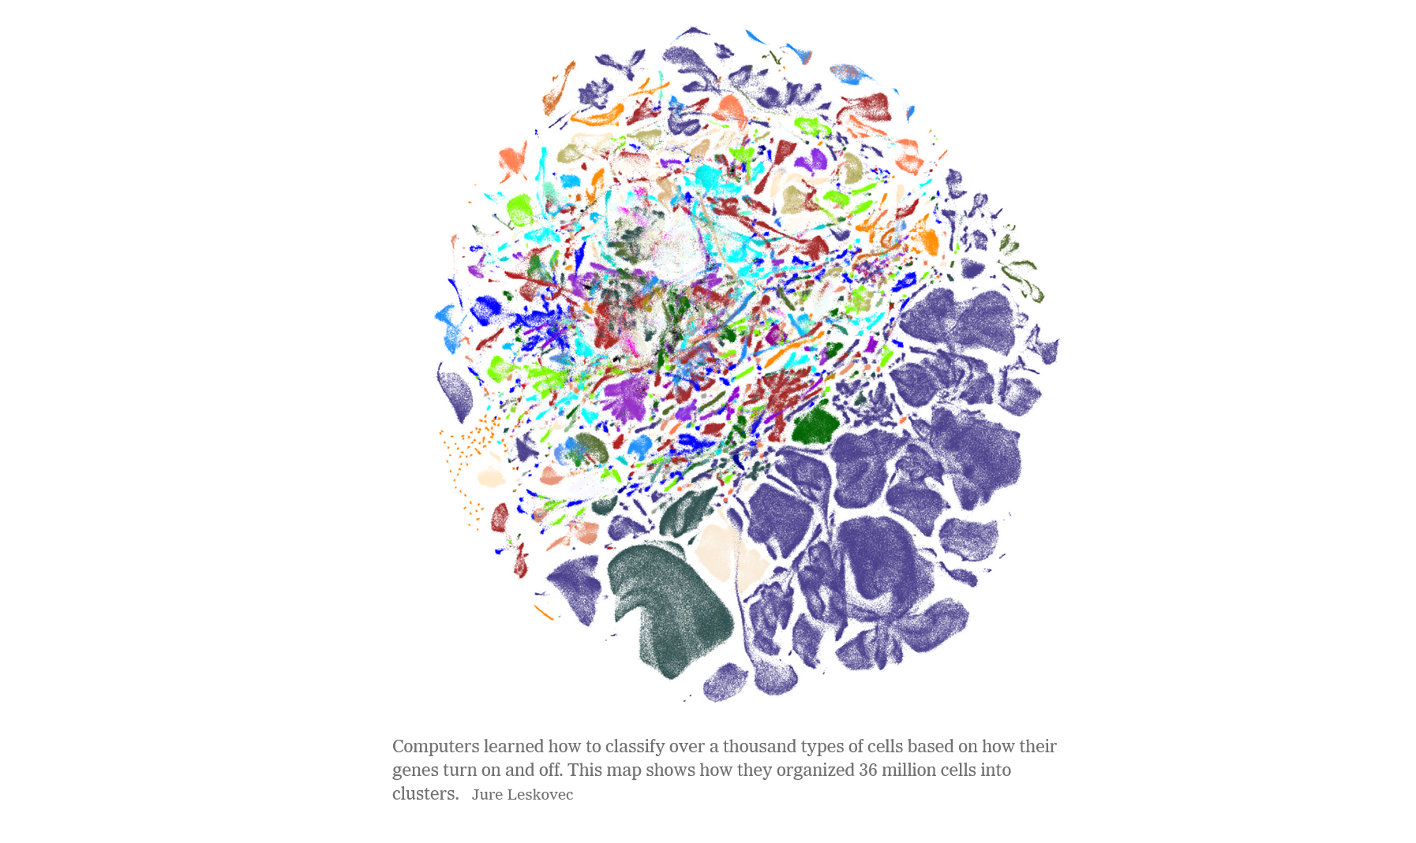

Slide 29


Slide 31

Anamnese/ verhaal
Klinische context
Expertise
generaliseerbaarheid
PATIENT
ARTS
Zelfkennis/
Zelfinzicht
kennis
Wetenschappelijke bewijsvoering
Verwachtingen van de patiënt

Slide 33
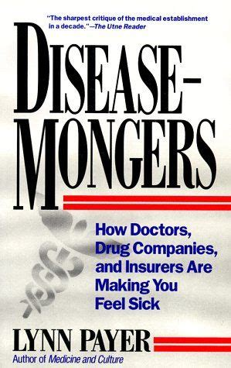
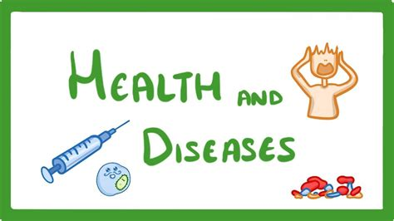

Slide 34
1/failures of information exchange
in information provided by the clinician (eg, too complex, not enough)
in missing information from the patient or failing toelicit it.
2These failures can be medically significant, affecting
adherence to prevention,screening,andtreatment;
undermining the patient-clinician relationship;
increasing anxiety and confusion;
exacerbating health disparities;
and accepting misleading, incomplete, or false medical information from ill-informed sources

Slide 35
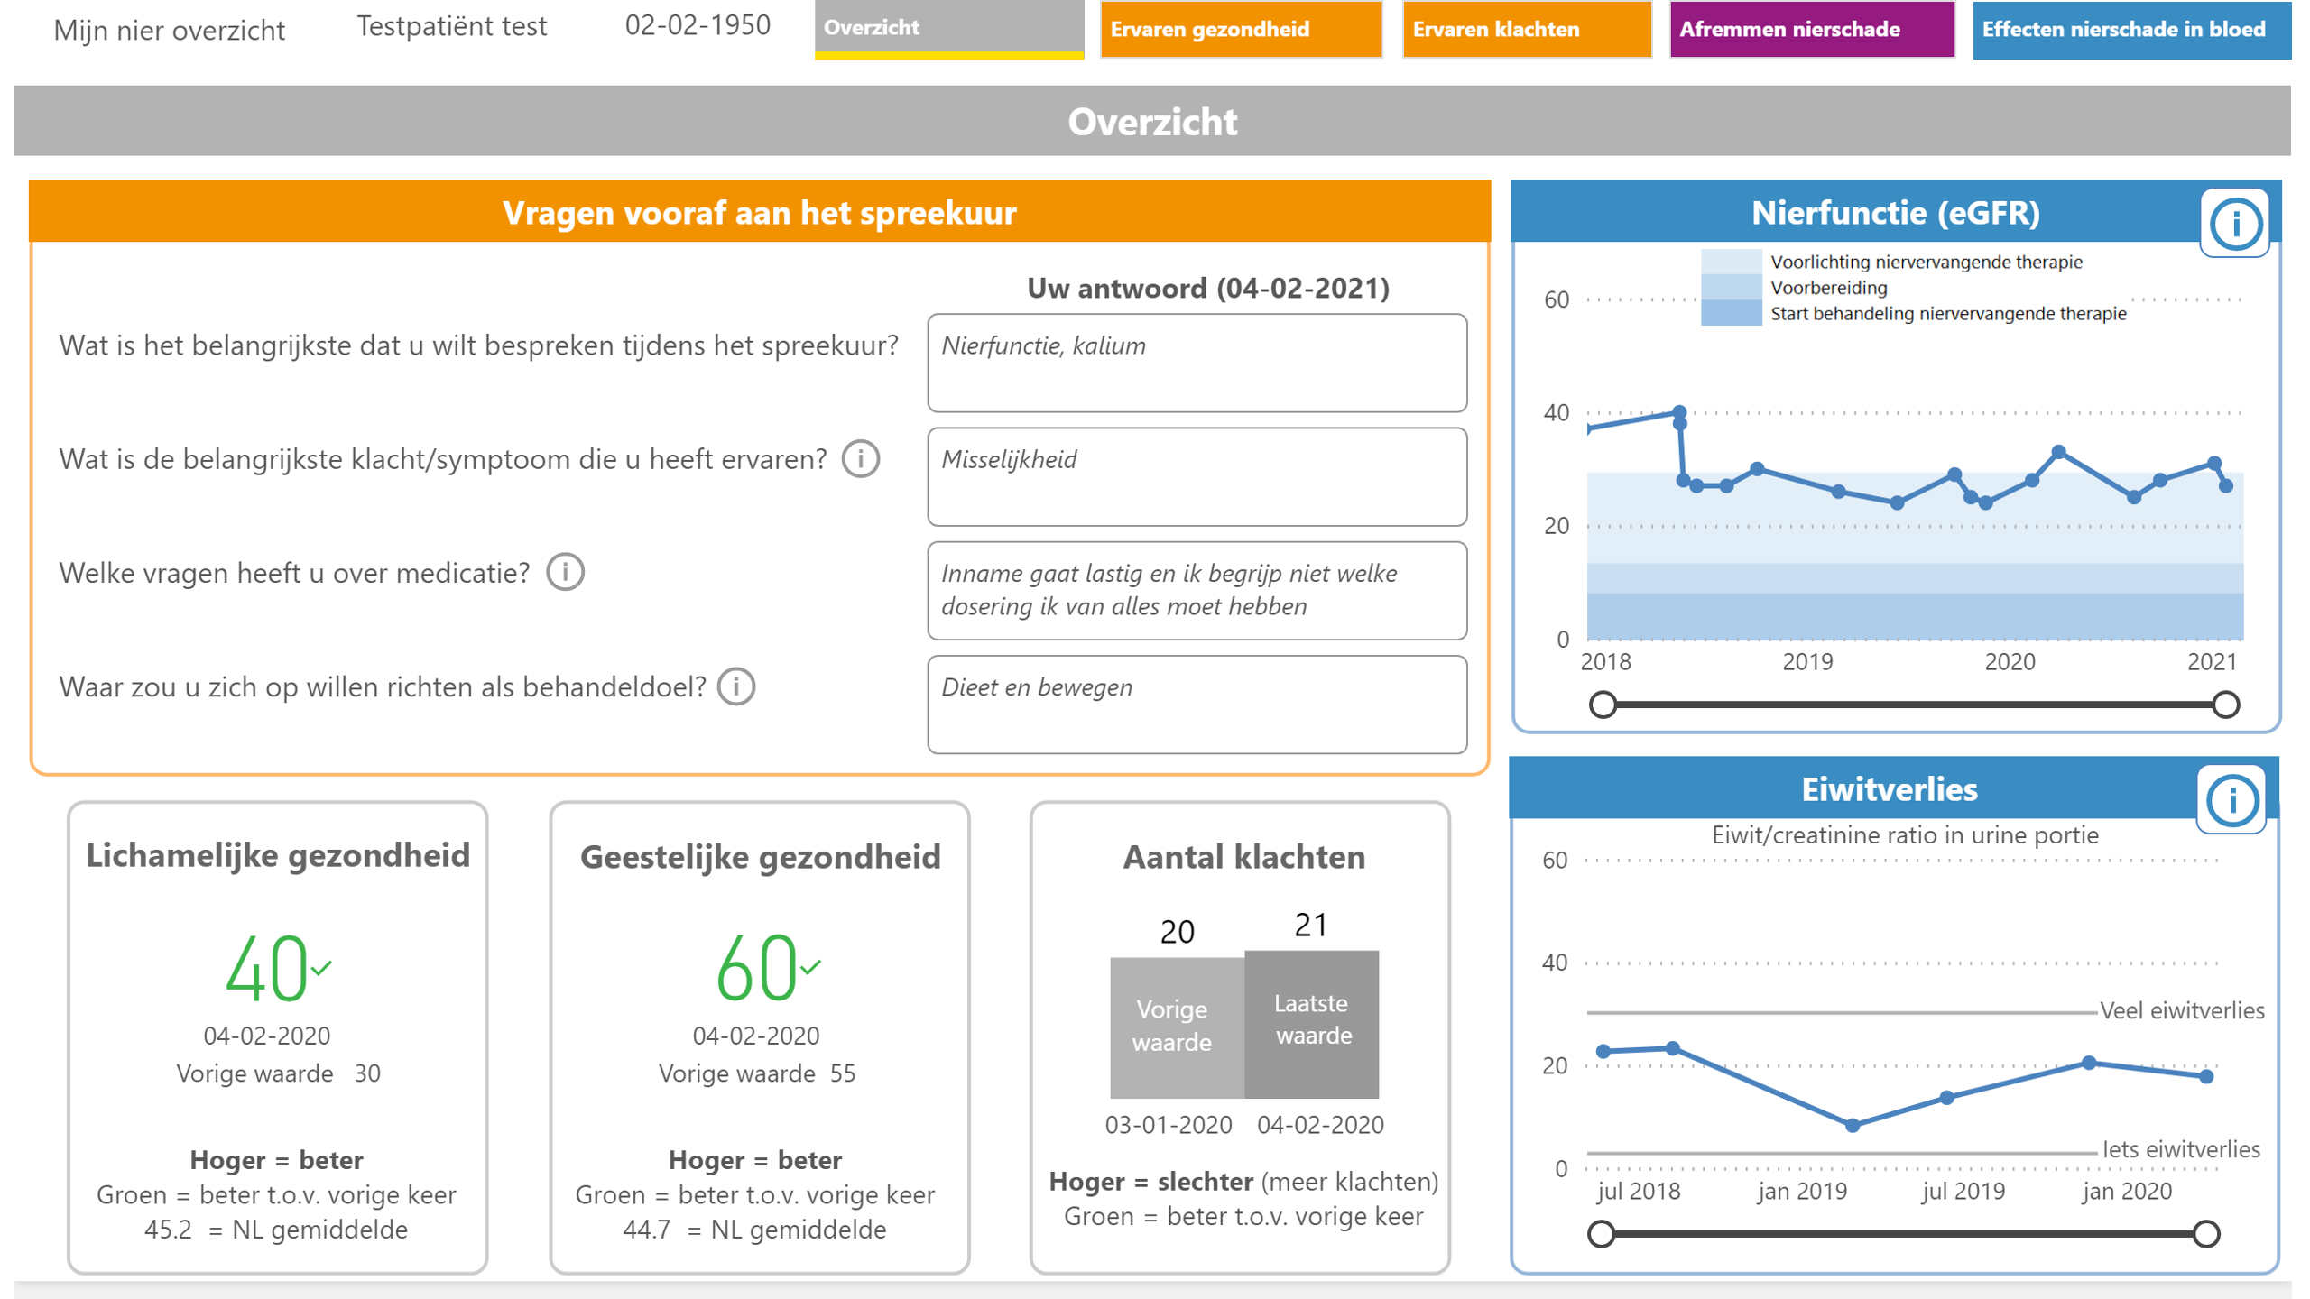

Slide 36
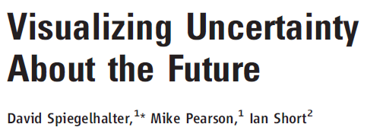
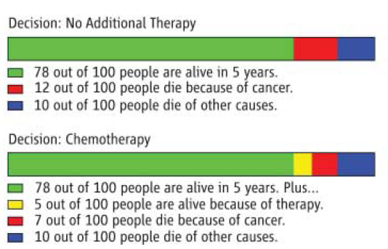

Slide 37

TRANSPARENCY

Slide 38
Prediction/Classification
Accuracy:
how well the interpretation of the data by the observer (classification/prediction) represents the facts/phenomena.
Note that in this setting, it is irrelevant whether data are causally related to the facts/phenomena, and that there is no need for a predefined model.
interprets
DATA
Observer
Test hypotheses about
represent
Are stored as
Phenomena
general
FACTS
singular
determine
MARKS
MEDIUM
Carrier of marks

Slide 39
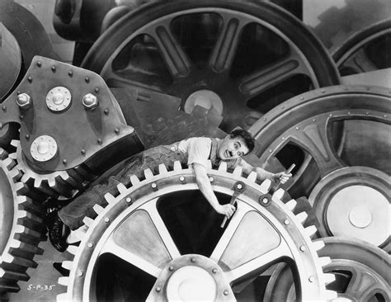
AI
Paternalism

Slide 40



Slide 43
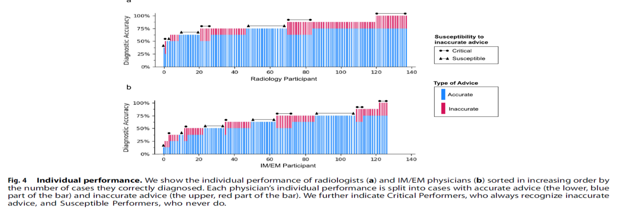

Slide 44
It is just like you [the physician] are a robot who needs to press on some buttons.” (R5)

Slide 45
It is just like you [the physician] are a robot who needs to press on some buttons.” (R5)
How does CDSS impact our role as a healthcare worker?

Slide 46
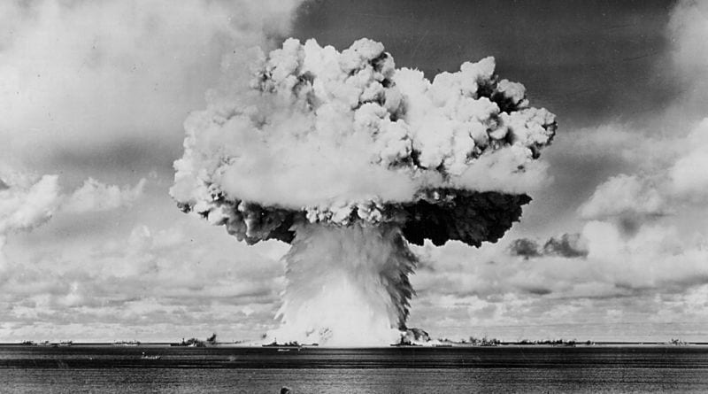
It is just like you [the physician] are a robot who needs to press on some buttons.” (R5)
How does CDSS impact our role as a healthcare worker?
Moral implications: the Manhattan Project

Slide 47
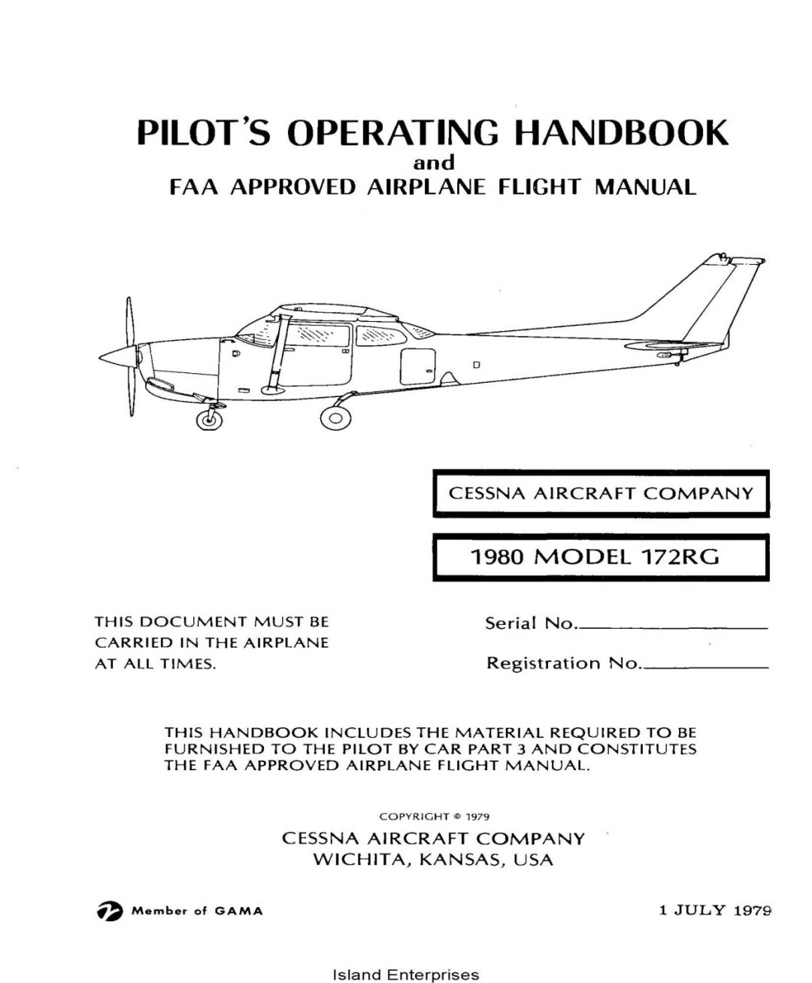
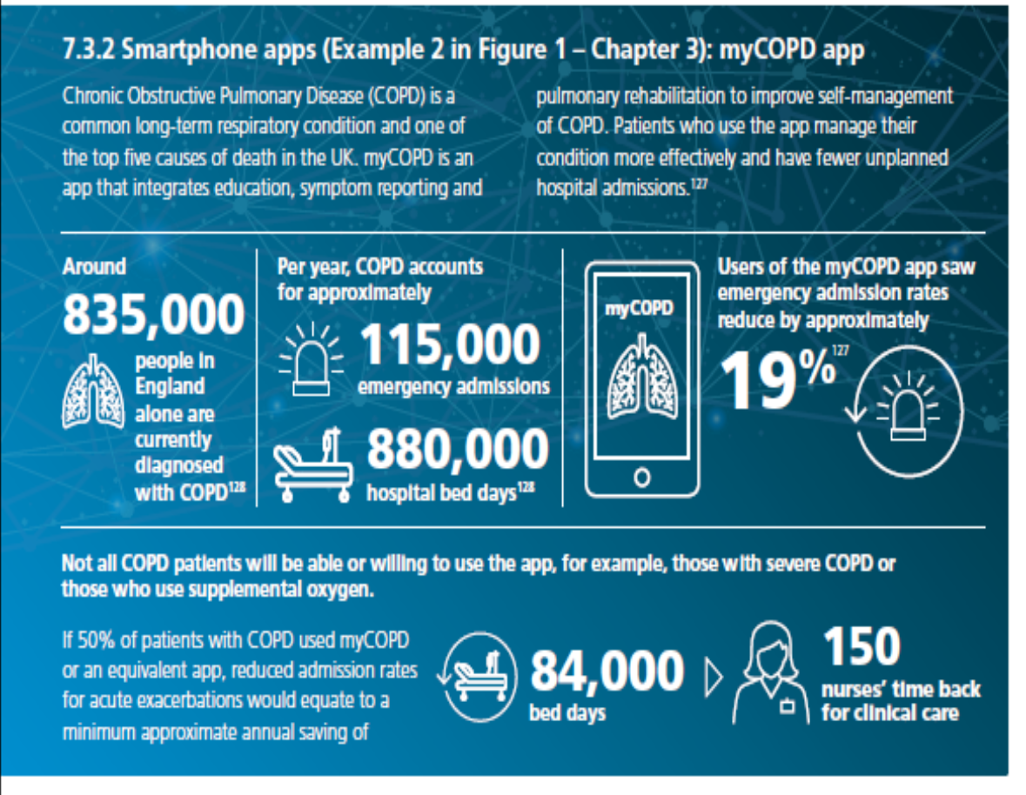

Slide 48
Simply having a human in the loop is not sufficient to accept “meaningful human control” if
  Human can only influence part of the process
  Does not dispose of (effective and true) information about the processes involved
  Has not the capacity to truly understand the consequences of the actions

Slide 49
Anamnese/ verhaal
Klinische context
Expertise
generaliseerbaarheid
PATIENT
ARTS
Zelfkennis/
Zelfinzicht
kennis
Wetenschappelijke bewijsvoering
Verwachtingen van de patiënt

Slide 50
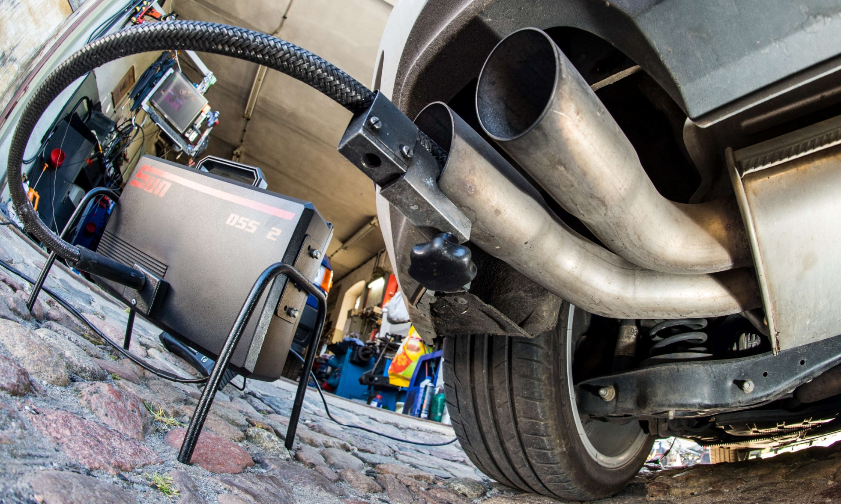

Slide 51
Target population
Target population
RCT sample (random selection)
RCT sample (random selection)
Generalisibility
Transportability

Slide 53
Anamnese/ verhaal
Klinische context
Expertise
generaliseerbaarheid
PATIENT
ARTS
Zelfkennis/
Zelfinzicht
kennis
Wetenschappelijke bewijsvoering
Verwachtingen van de patiënt

Slide 54
uncertainty
Radical uncertainty
Probability
ambiguity
complexity
Computational irreducibility
CONTEXT

Slide 55
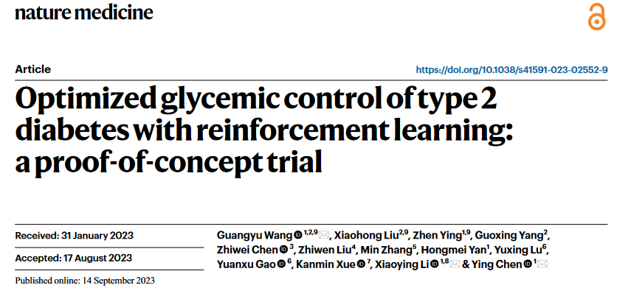

Slide 56
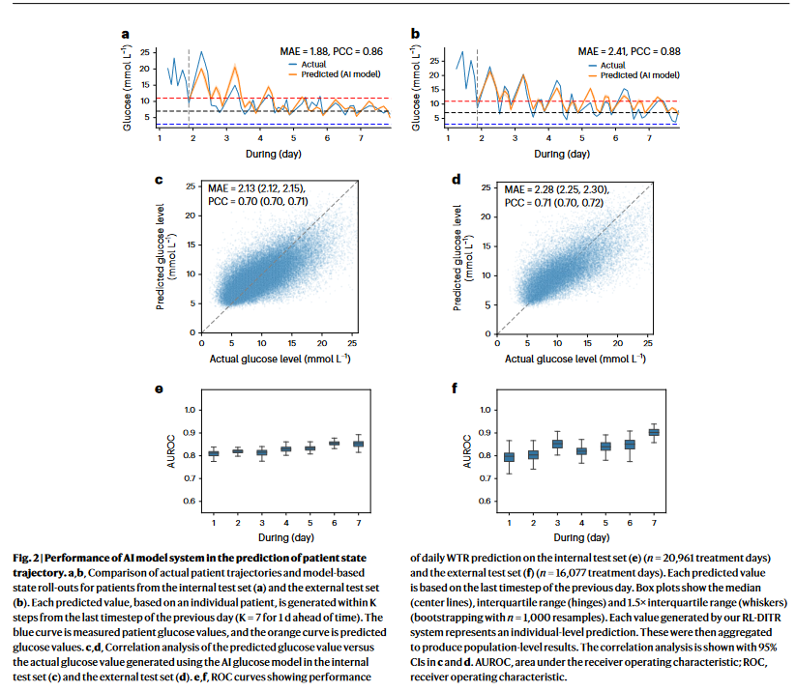

Slide 57
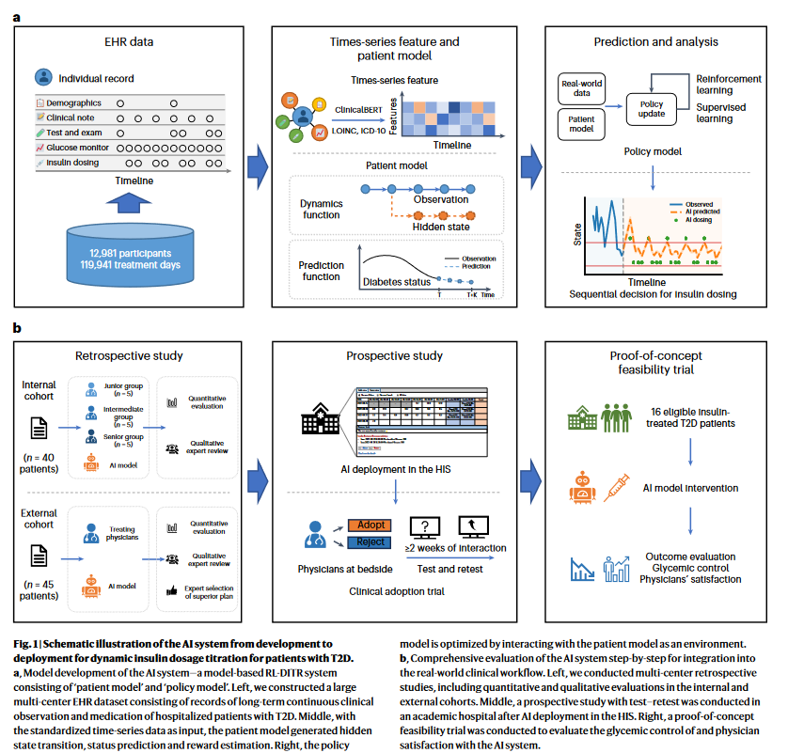

Slide 58
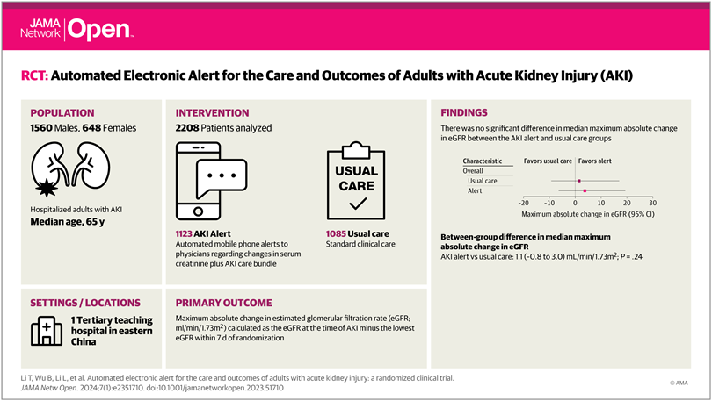
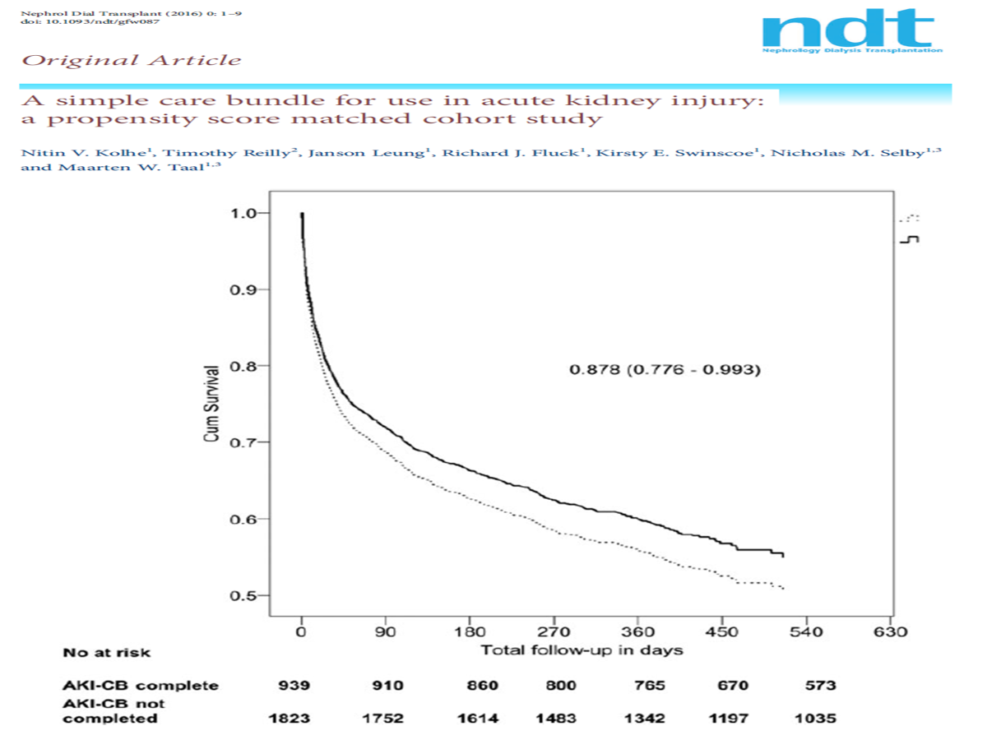
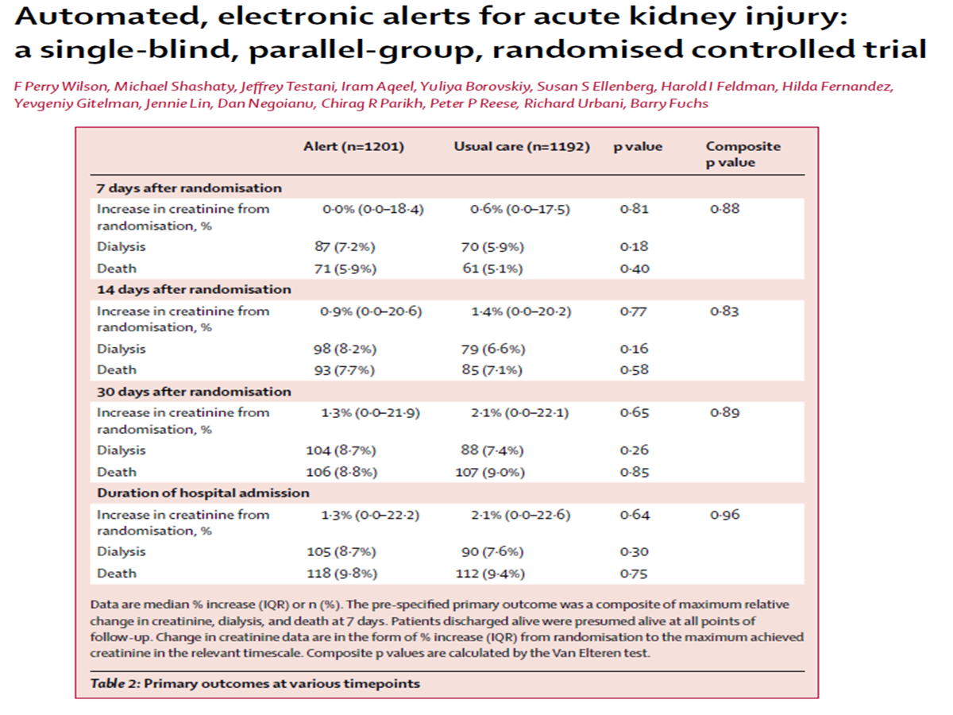

Slide 59
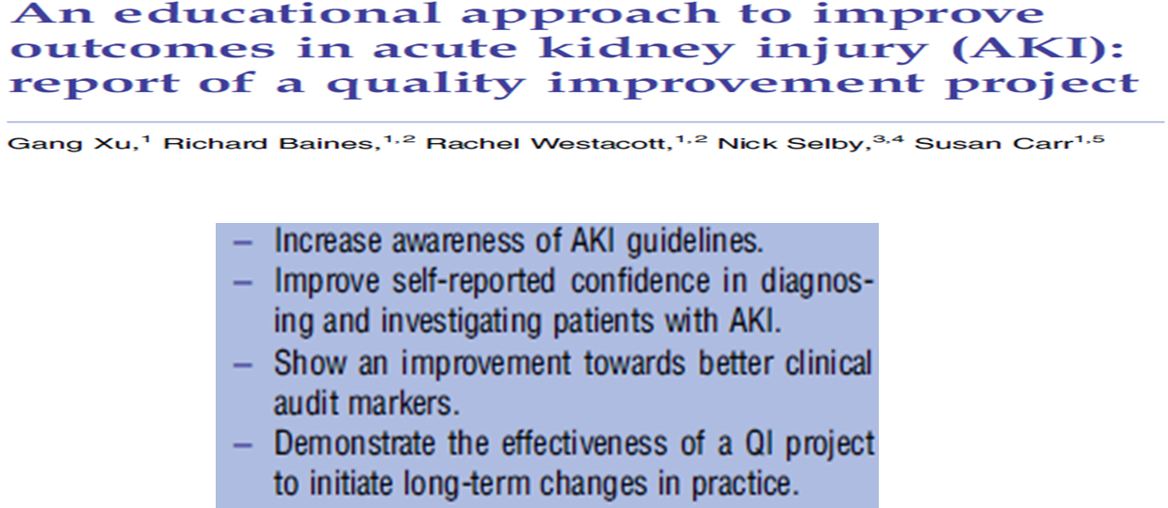

Slide 60
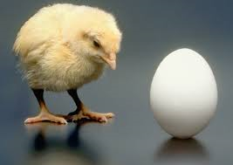
Change in paradigm
  => AKI is an ICU condition
  => treating AKI will improve mortality

Slide 61

Change in paradigm
  => AKI is an ICU condition
  => treating AKI will improve mortality
AKI is THE cause of death

Slide 62
Change in paradigm
To improve AKI outcome we need to improve ICU AKI care
  => AKI is an ICU condition
  => treating AKI will improve mortality
Attributable Mortality

Slide 63
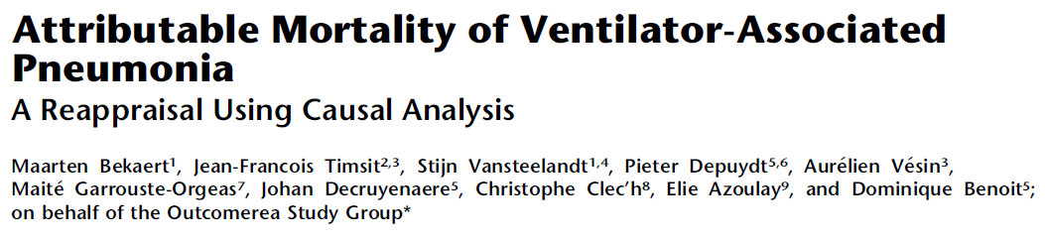
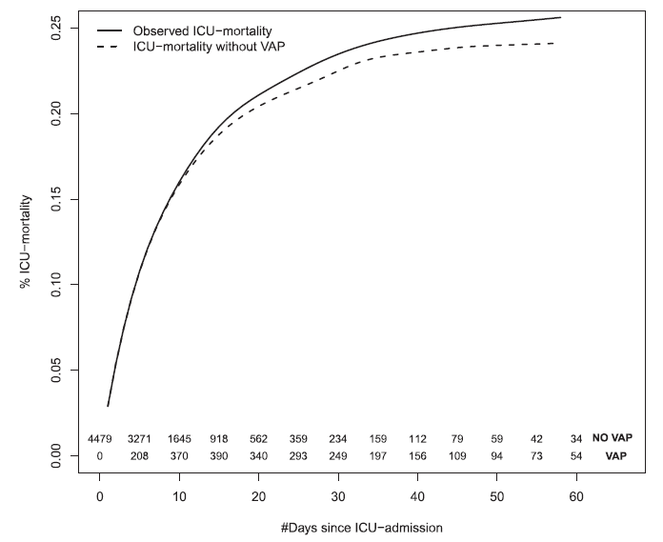

Slide 64
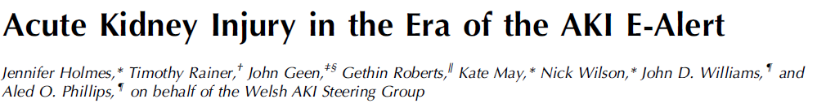
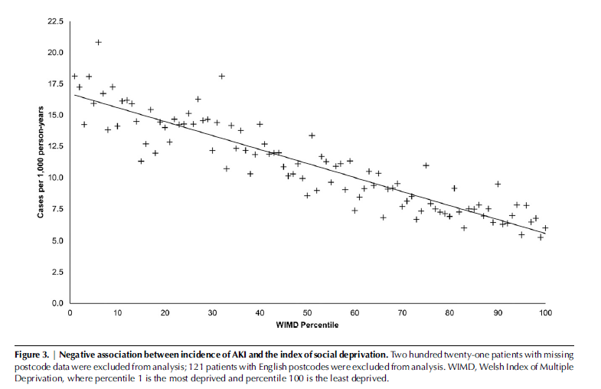

Slide 66
Fail to provide care that is focused on patient and family needs
Can’t consistently measure outcomes that matter to patients
Gaps in accessibility and equity
Economic sustainability
Ecologic sustainability
Workforce shortages

