Slide 1
EQUITY in provision of Kidney Care
General considerations on equity
Equity: a framework
Equity in kidney disease

Slide 2
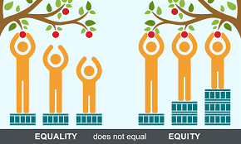
EQUITY
Notes:
This is an important slide I believe to explain what is equity and how it differs from equality

Slide 3
EQUITY
Rules/organisation
the SAME
for everyone?
Rules/organisation
FAVOR
disadvantaged populations
FAIRNESS
(providing everybody
what is needed)

Slide 4
EQUITY
Inequity arises when systematic disadvantage for certain people of a group result in loss of wellbeing in all of its dimensions, and this is merely because of reasonably modifiable factors associated with being a member of that group.

Slide 5
EQUITY
OUTCOME
ALLOCATION
PERFORMANCE

Slide 6
OUTCOME

Slide 7
PERFORMANCE OF PREVENTION

Slide 8
Bubble size: % of health budget spent on RRT
Allocation
Y axis: % of GDP spent on health
X-axis: GDPc
Courtesy A. Vandertol, R. Vanholder

Slide 11
CKD

Slide 12
Dialysis

Slide 14
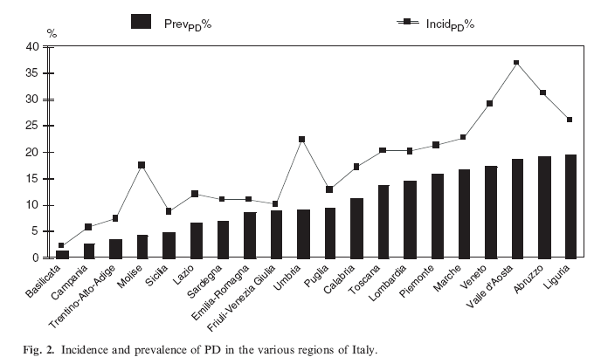
PD prevalence and incidence in Italy
Viglino et al, NDT, 2007

Slide 17
EQUITY
=> Everything in this topic should be discussed through the lens of EQUITY.
Examine existing models of care, e.g., what is good and bad, does it promote equity or not, and if not, how to fix it, what are possible solutions (not too prescriptive)?
Distributive
Versus Justice
Commutative
Rules/organisation
the SAME
for everyone?
Rules/organisation
FAVOR
disadvantaged populations
FAIRNESS
(providing everybody
what is needed)

Slide 18
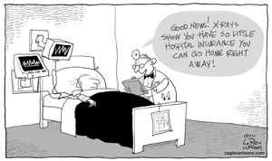
Commutative justice:
Everybody pays to insurances what he wants
Everybody gets out of his insurances what he has paid for

Slide 19
Commutative justice:
Everybody pays to insurances what he wants
Everybody gets out of his insurances what he has paid for
Bvb hospitalisatie verzekeringen
Prices go up
Inequity ensues
  Poor do not get access
  Rich get care they do not need
Mostly LIBERTARIAN

Slide 20

Distributive Justice
Everybody pays to insurance what he/she can afford according to a predefined set of rules
Everybody gets from insurance what he/she needs according to a predefined set of rules
Bvb Belgische Social Security
Inforces re-distribution of wealth and health
principle of solidarity
Only feasible/realistic when everybody contributes accoding to possibilities
Requires predefined set of rules of what will be reimbursed
Mostly EGALITARIAN

Slide 21
Some overlap however…….
Medicare in US
Utilitarian approach

Slide 22
Some overlap however…….
Medicare in US
Utilitarian approach
Social Justice:
=> Good health concerns more than just medical healthcare
Enkele slides van Marmot in te voegen

Slide 24
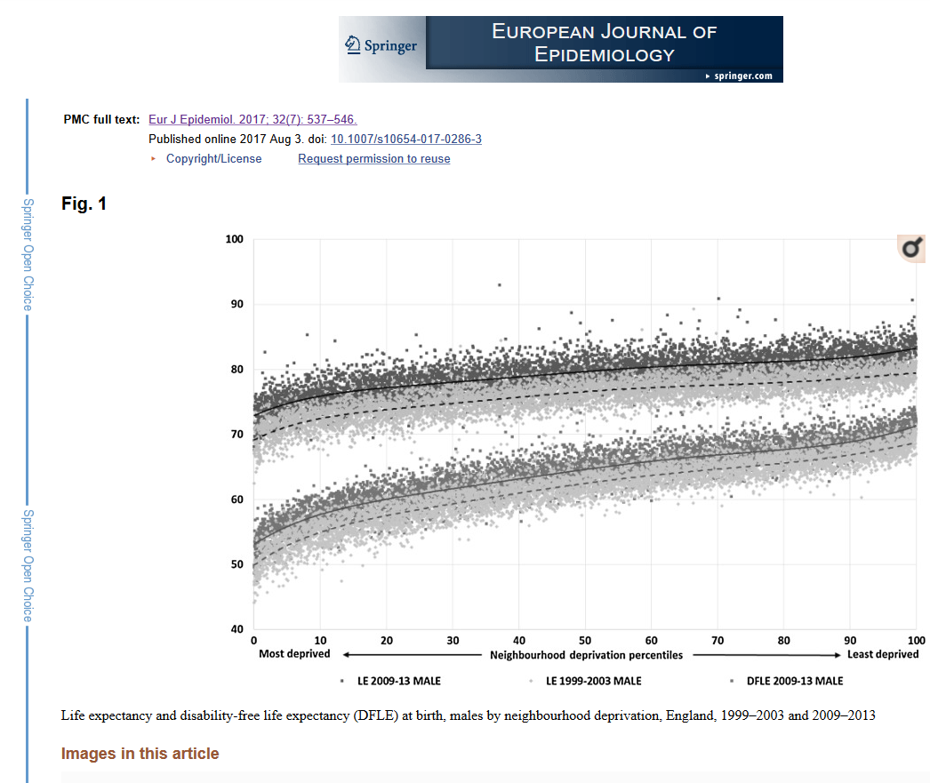

Slide 25
RRT Funding in selected countries
 | Mexico | Colombia | Thailand | Malaysia | Singapore
Social Security ª HD PD Kidney Txp | 100% 100% 100% | 51% 59.9 81.6 | minimal minimal minimal | minimal minimal minimal | minimal minimal minimal
Gov. Subsidized ^{b} HD PD TXP | minimal minimal minimal | 46.6 36.5 18.1 | 61% 95% --- | 58% 100% 100% | minimal minimal minimal
NGO’s subsidies | minimal | none | < 10% | < 10% | 68%
Providers NGO’s For-profit units Hd PD | minimal 32% | none 100% 100% | largely | minimal largely | 68% minimal
ª By general taxation, and employers and employees payroll taxation
^{b} By general taxation

Slide 26
AVAILABILITY
EQUITY
Services and professional providers
HD, PD, TX
Physicians, nurses, technicians, social service….
Vascular access, TX surgeons

Slide 27
AVAILABILITY
EQUITY
Services and professional providers
HD, PD, TX
Physicians, nurses, technicians, social service….
Vascular access, TX surgeons
      How to retain professional experts if there is no patients?
      How to grow patients if there is no services/professionals

Slide 28
AVAILABILITY
EQUITY
Services and professional providers
HD, PD, TX
Physicians, nurses, technicians, social service….
Vascular access, TX surgeons
Geographical: city vs rural
      Maldistribution
      Transport possibilities and migration options➔ inequity
      Need for decentralized access to (basic) services
      Need for protocols and procedures on basic services
      Need for online support options (trouble shooting)

Slide 29
AVAILABILITY
EQUITY
Services and professional providers
HD, PD, TX
Physicians, nurses, technicians, social service….
Vascular access, TX surgeons
Geographical: city vs rural
Financial status:
High vs low income
Insured vs non insured
Employed vs non employed
CAVE: out of pocket costs and financial disaster

Slide 30
AVAILABILITY
EQUITY
Services and professional providers
HD, PD, TX
Physicians, nurses, technicians, social service….
Vascular access, TX surgeons
Geographical: city vs rural
Financial status:
High vs low income
Insured vs non insured
Employed vs non employed
Education/knowledge

Slide 31
AFFORDABILITY/ACCEPTABILITY
EQUITY
Vertical organisation of health provision
        no general holistic (horizontal) view on health care
        WHO recommendations on UNIVERSAL HEALTH COVERAGE
          prevention
          equity
          sustainability

Slide 32
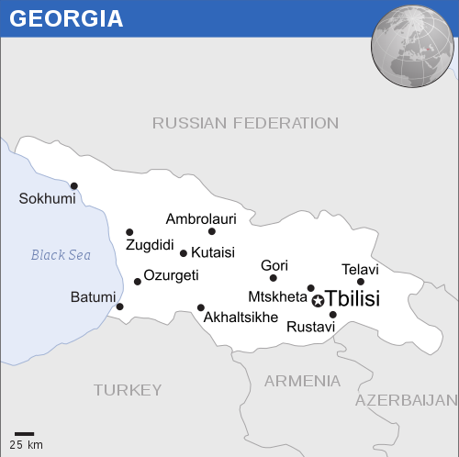
AFFORDABILITY/ACCEPTABILITY
EQUITY
Vertical organisation of health provision
        no general holistic (horizontal) view on health care
        WHO recommendations on UNIVERSAL HEALTH COVERAGE
          prevention
          equity
          sustainability

Slide 33
AFFORDABILITY/ACCEPTABILITY
EQUITY
Vertical organisation of health provision
        no general holistic (horizontal) view on health care
        WHO recommendations on UNIVERSAL HEALTH COVERAGE
          prevention
          equity
          sustainability
The WHO estimated that to achieve the WHO sustainable development goals (SDG) in LMIC a substantial financial effort with a minimal total available health care budget per person of $271 (range 74-984), or an expenditure of 7.5 (2.1-20.5)% of gross domestic product (GDP) to health care is requested.

Slide 34
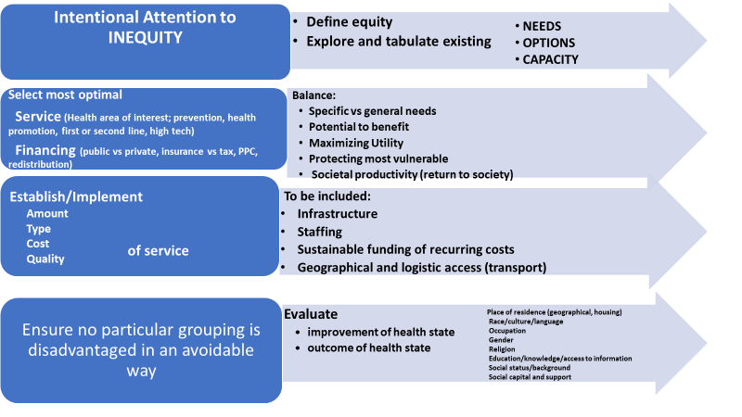
approach to improve equity in ESKD care

